Slide 1

APPLICATION SECURITY
(Threats and Malpractices)
Speaker: Dimitrios Valsamaras | @Ch0pin
https://www.linkedin.com/in/valsamaras/

Slide 2

Common Malpractices
Webviews
Floating Windows
Accessibility Service
Administration API
Reflection
Dynamic Code Loading

Slide 3

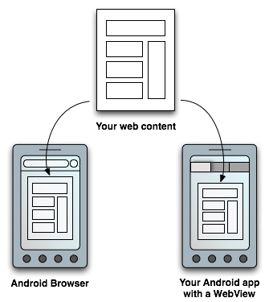
Webviews
Usage: WebView objects allow the developers to deliver web-based content to the user as a part of an activity’s layout.
Customization
Increased control over the UI

Slide 4
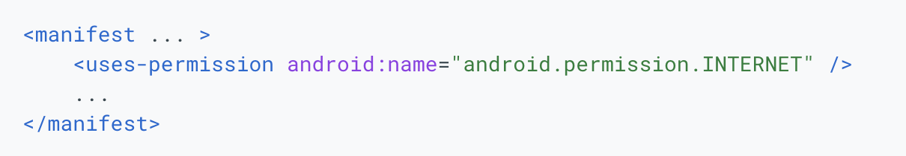
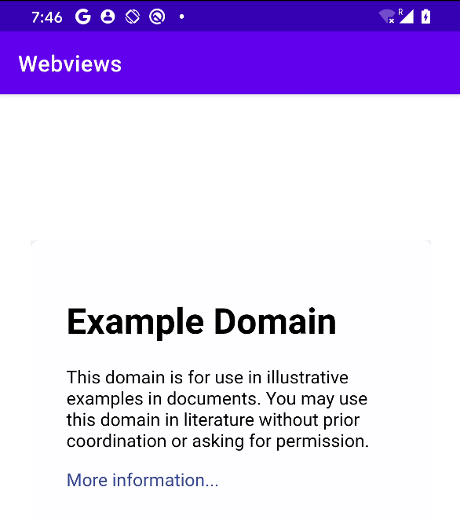
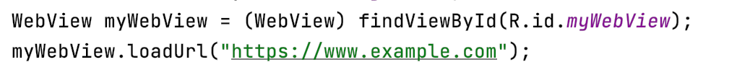
Webviews - Basic Usage

Slide 5
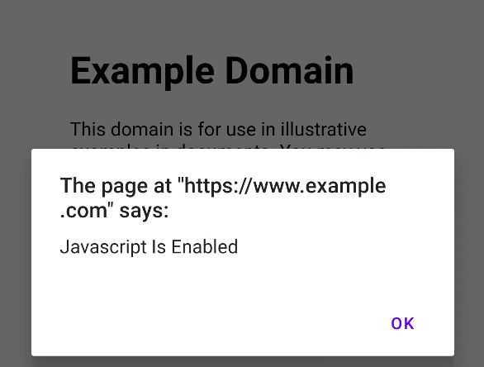
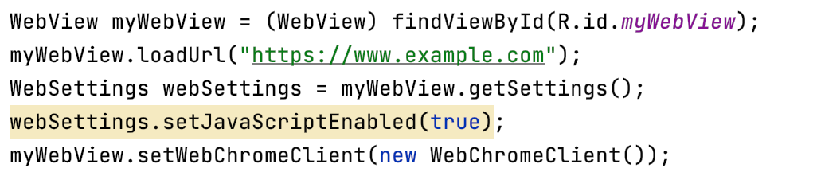
Webviews - Enabling Javascript

Slide 6
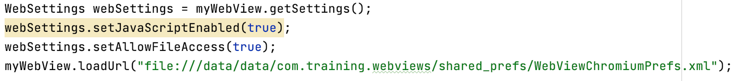

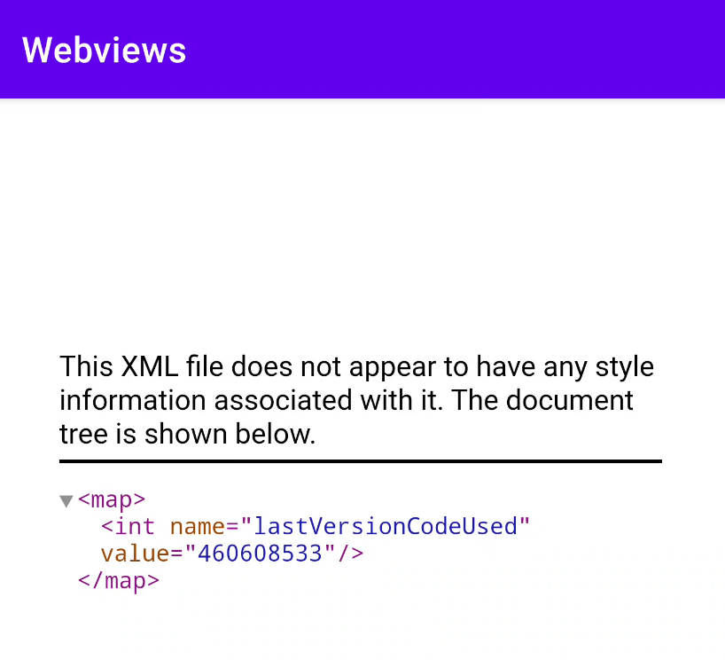
Webviews - Enabling File Access
? ?

Slide 7
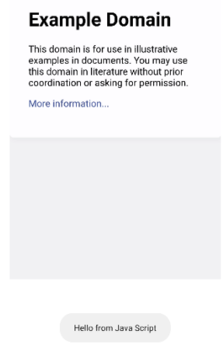
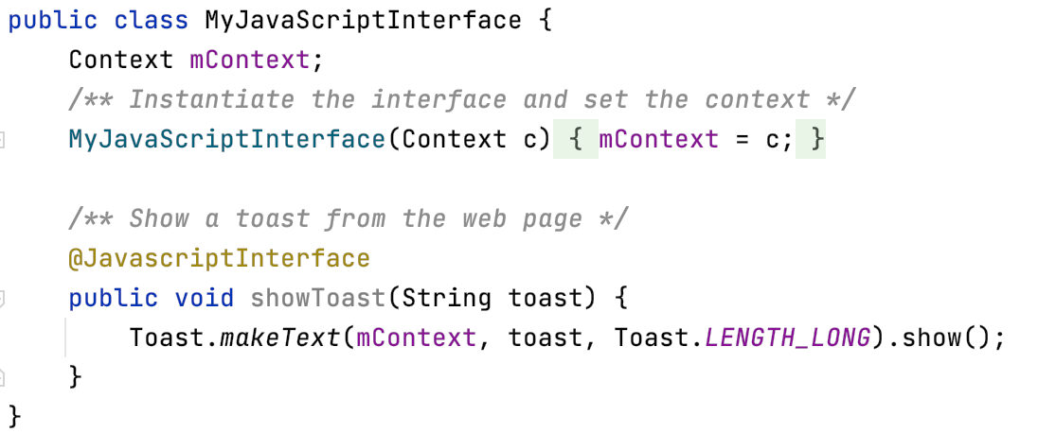
Webviews - Bridging Java with Javascript
Javascript:
function showAndroidToast(toast) {
AndroidBridge.showToast(“Hello from Java Script”);
}

Slide 8
Webviews - Malpractices
Intentional

Slide 9

Webviews - Malpractices
When misused WebViews impose a great risk for the user !!
Common Malpractices:
Javascript Injection
Web Scraping
Backdoor-ing
Silent Loading

Slide 10
WebViews - Javascript Injection
Using the onPageStarted, onPageFinished callbacks or the onProgessChanged (less common) we may track the loading process of a web page and append arbitrary code.
myWebView.setWebViewClient(new WebViewClient() {
@Override
public void onPageFinished(WebView view, String url) {
super.onPageFinished(view, url);
INJECTION POINT
}
});

Slide 11
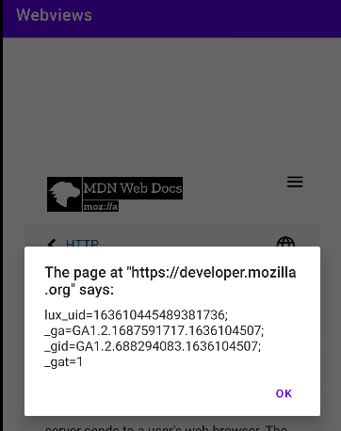
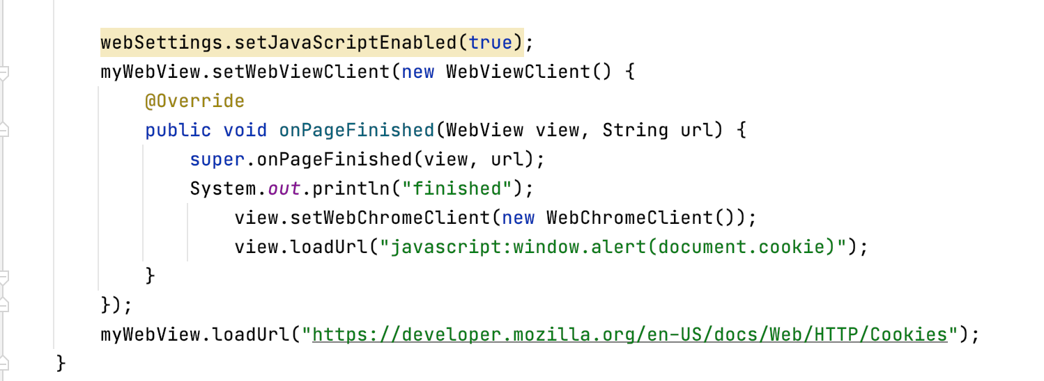
WebView - Javascript Injection - Cookies

Slide 12
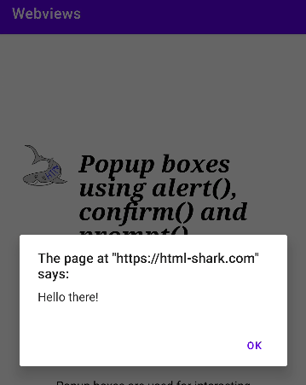
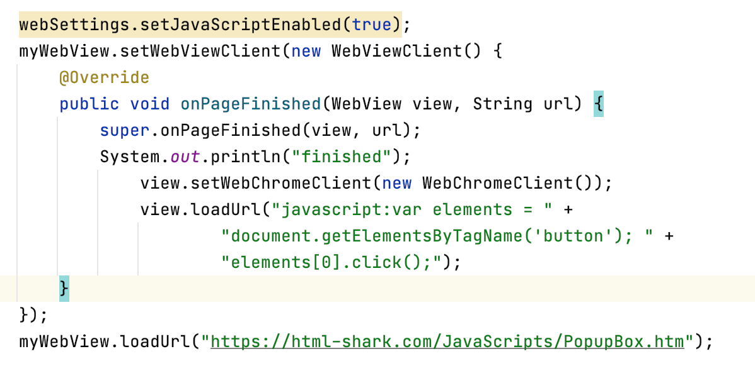
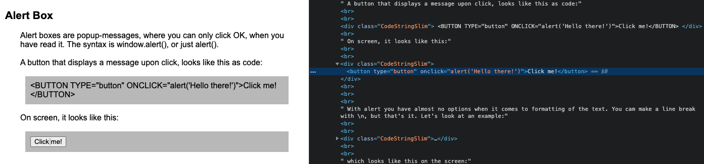
WebViews - Javascript Injection - Auto Clicks

Slide 13
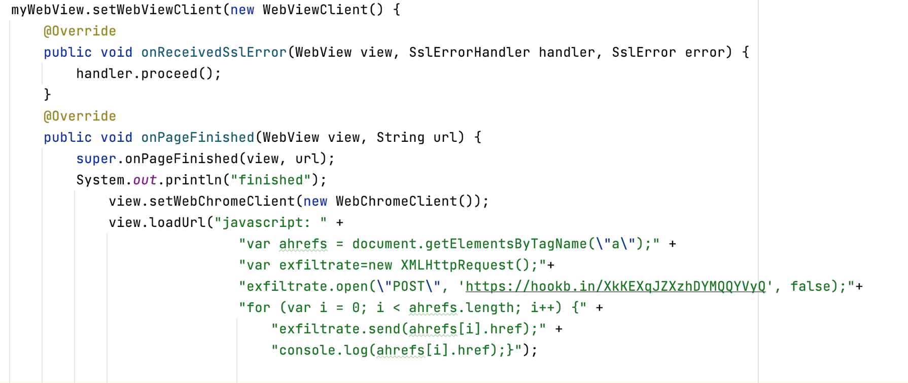
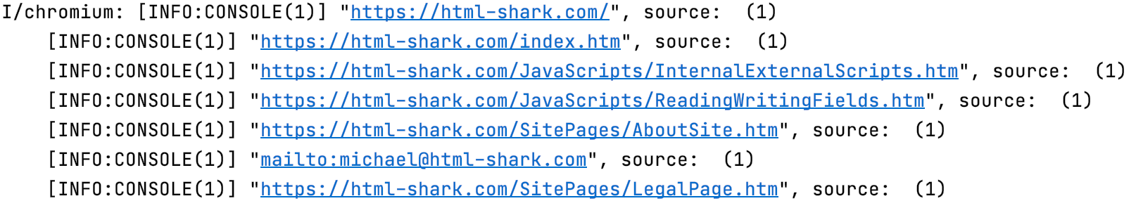
WebView - Javascript Injection - Scrapping

Slide 14
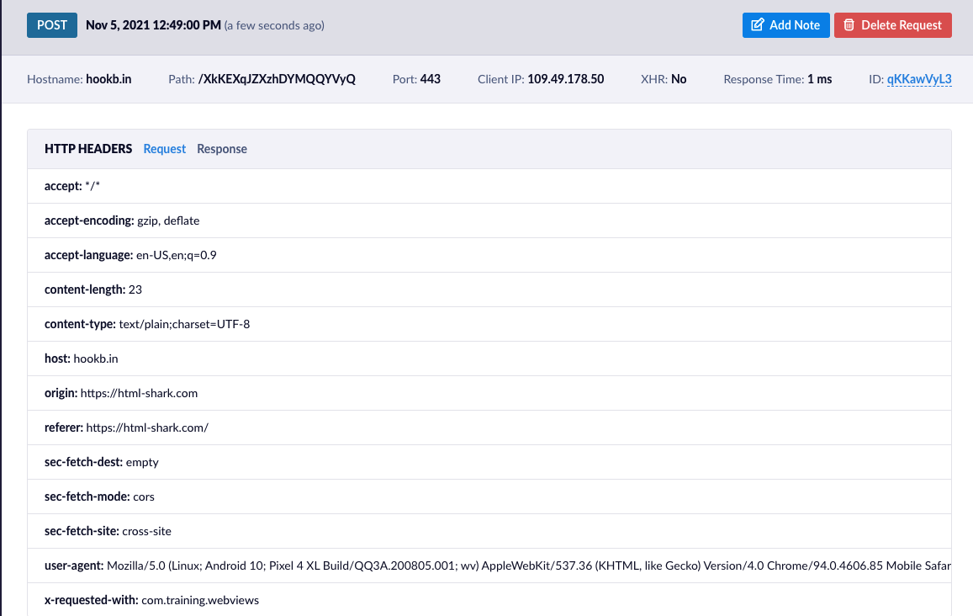
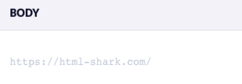
WebView - Javascript Scraping

Slide 15
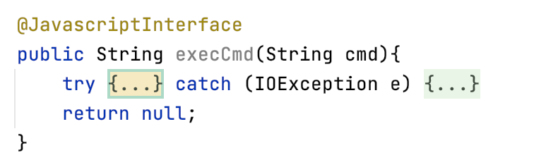

WebView - Backdooring

Slide 16

WebView - Silent Loading
By changing the visibility or the size of the webview all the operations can take place without being perceived by the user:
myWebView.setVisibility(myWebView.GONE)

Slide 17
Webviews - Malpractices
UnIntentional

Slide 18
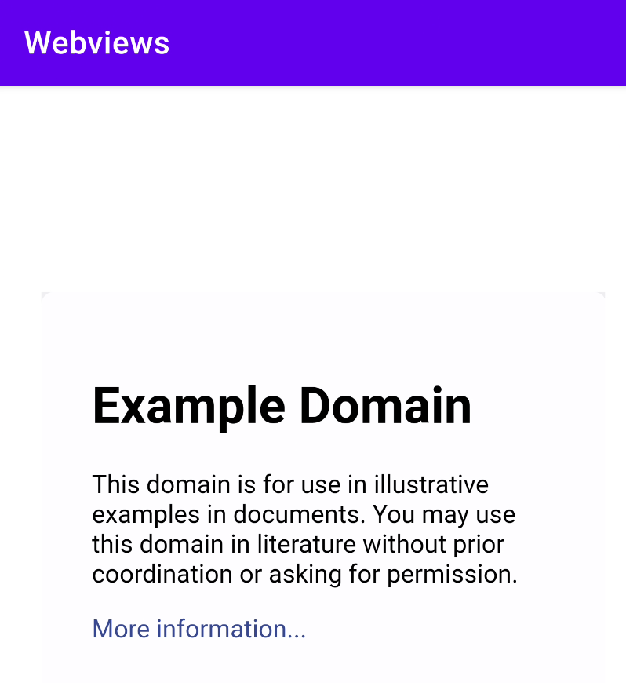
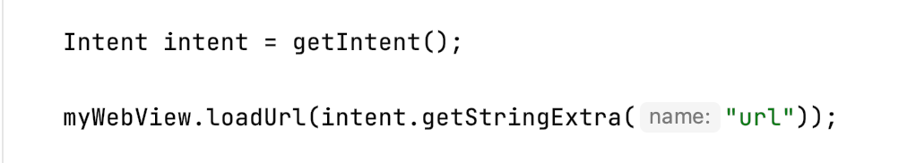
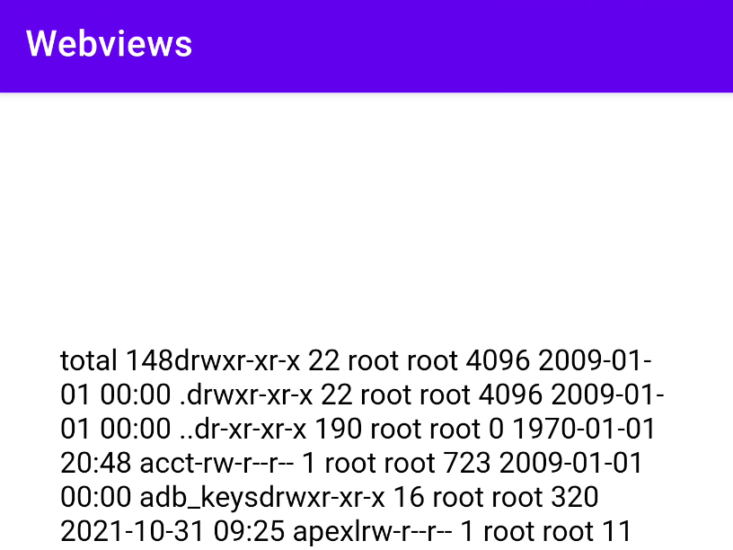
WebView - Hijacking
am start -n com.training.webviews/.MainActivity --es url https://www.example.com
am start -n com.training.webviews/.MainActivity --es url "javascript:AndroidBridge.execCmd('ls -al')"
Get the code https://github.com/Ch0pin/WebViews

Slide 19
References
https://developer.android.com/reference/android/webkit/WebView

